Slide 1
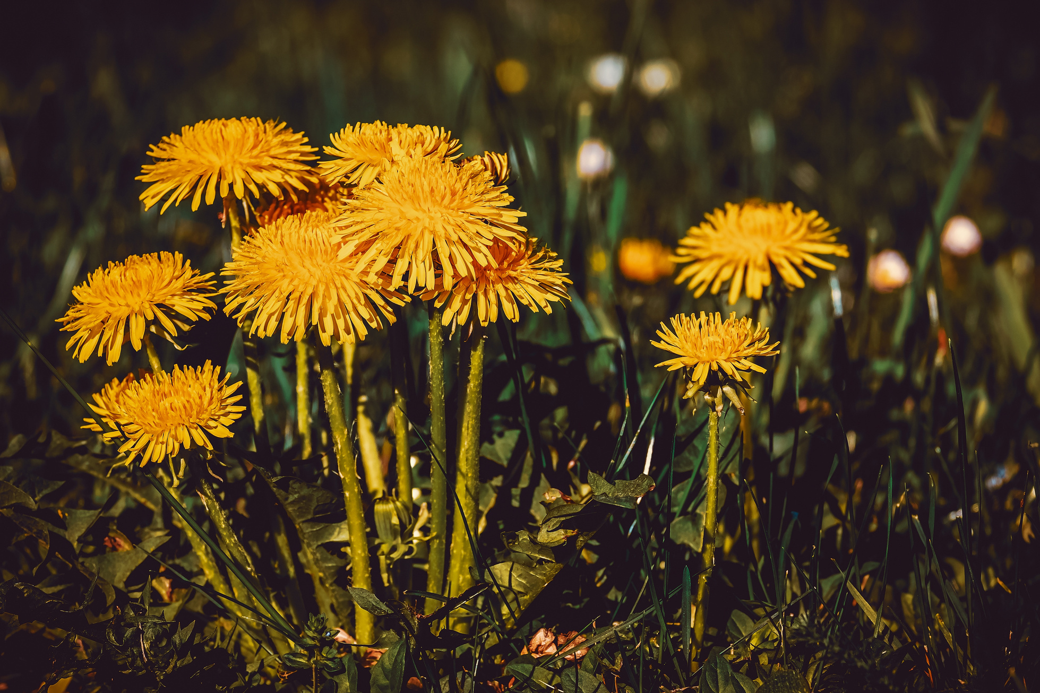
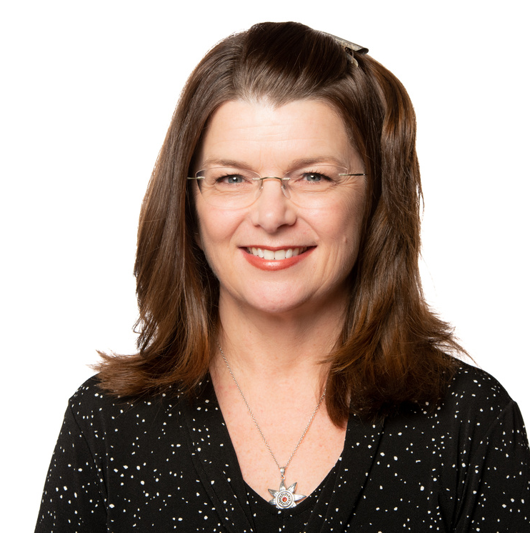
Tell a STEM Story

Slide 2
Communicating STEM to a General Audience
Results & Implications
Need to Know
Methods & Details
Background & Context
Nice to Know

Slide 3
What is the 3 Minute Thesis?
academic competition
focused on presentation and communication skills
3 minutes, one static slide
non-specialist audience

Slide 4
Feature the 'So What' first
Top 5 Tips for sharing STEM
Use plain language
Share with a non-specialist
Use analogies, stories and relatable examples
Target your audience
Are they homeowners, tax payers, healthcare professionals, parents, public servants, gardeners, teachers, investors, students, children?

Slide 5
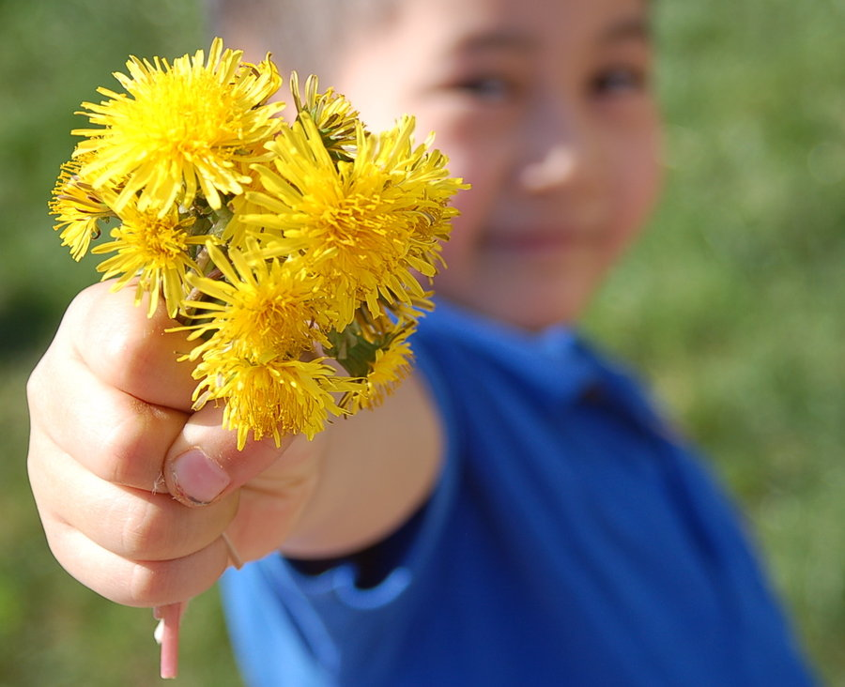
Kids like Dandelions

